Slide 1


Item Promos & USI
Getting 1% Better Every Day
Kelly Peterson
Date: August 2024

Slide 2
Background
Item promos (e.g. buy one get one free, free item) are a great way for Mx to drive sales & subtotal, and a very attractive offer for Cx to save money. However, at scale Cx are experiencing issues in their overall experience with these promos that is causing Cx frustration and could lead to drop off.
Research Objective
This research is meant to identify the key areas of friction and frustration and the short term and long term solutions to ensure a seamless item promo experience for Cx.
Full Research Brief Here
Methodology
8 X 45 min 1:1 interviews -
All Cx had placed an order in the P30 days
All Cx indicated some level of interest of using deals on DoorDash with varying levels of price sensitivity

Slide 3
Summary of Recommendations
See detailed recommendations starting at slide 19

Slide 4
Item Promo: Immediate Needs
Item Promo: Longer Term Solutions
Overall promo experience: Systematic needs
Exclude low value item promotions from Mx options
Only allow one item promo per Mx to avoid confusion until stackability is possible
Only show strikethrough on menu page of the deal that is being highlighted in the progress bar/cart.
Item details should be edited by content and tested to create a template that ensures clarity & simplicity
For high value item promos indicate the item (e.g. app, entree, dessert) in the badge description for clarity. On the store page, the badge should include the pricing (e.g. $0 when spend $20+)
Continue to push to have some sort of item visual or text explanation within the USI to identify free items
Location of merchandising (featured vs. menu section) matters less because of USI
There is a broader need for consistent badge requirements. Ideally all badges should include value and any minimum spend requirements.
We closely with the checkout team to streamline and clarify how deals are shown within the cart summary, as well as, how and where they can swap between promotions on the cart page

Slide 5
Optimizing the Cx experience around item promos

Slide 6


While Cx are excited by promotions; they are also skeptical of deals
Half of Cx expressed some level of skepticism about deals on DoorDash. They expressed concerns that prices were inflated to give the perception of savings, or that even with savings it is still more expensive than going in person to a Rx.
Some of the Cx skepticism comes from confusion around the deals themselves. Cx cite inconsistencies across badges, deal descriptions and requirements that make it confusing to know when a deal is a good deal. Cx feel that the value and requirements should be shown in a consistent manner.

Slide 7


Cx are most interested in deals with “tangible value”
Cx like when….
Cx dislike when….
Deals have free delivery because it removes a clear expense and guilt around ordering
Have a concrete number off that doesn’t require math or feel arbitrary
BOGO for the value of the deal
Deals have high minimum amounts (over $25)
Deals have low value (under $5)
Deals are inconsistent are confusing to understand
BOGO does not allow flexibility in the items
“Like no minimum or no delivery fee? Yeah those (I like).”
“BOGO are helpful”
“Something like $5 off, that’s not great”
“When I have to spend $50 to get something, it's just not gonna happen”

Slide 8
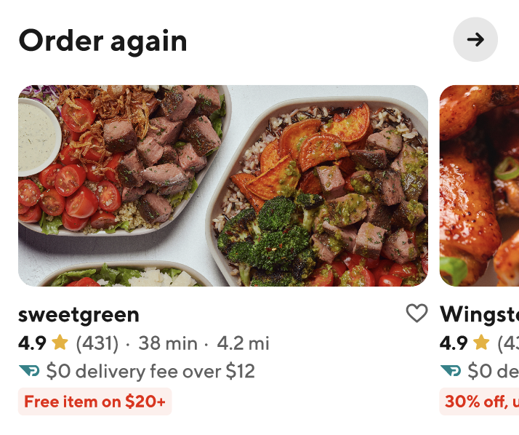
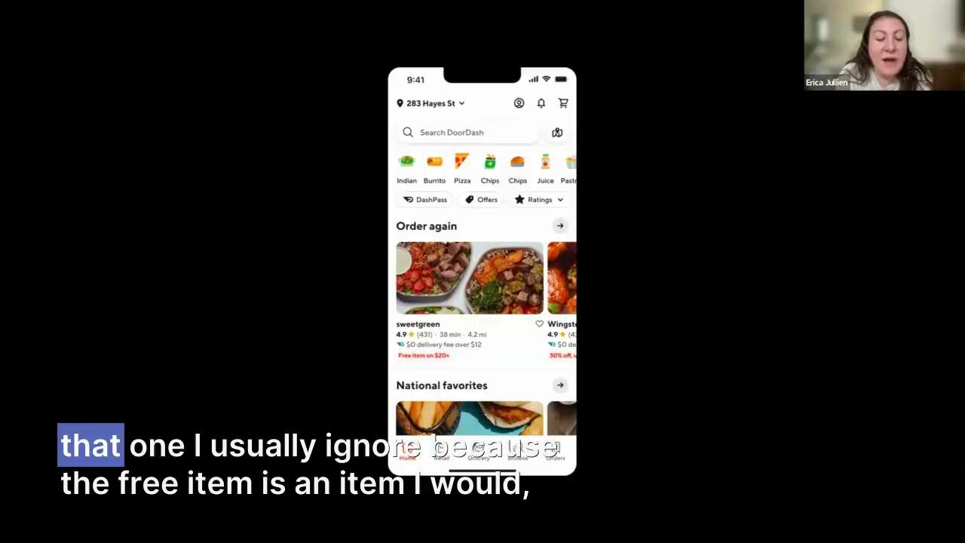
Free item badge does not garner much attention or interest from Cx
Reactions to “Free item” badge on homepage compared to other deal badges:
Very few Cx indicated interest in the free item or free item deals in general:
Cx assume the item is low value (e.g. soda, fries or dessert) and not worth ordering from a Rx for
Cx assume they will not like the item that is free
Some Cx worry the Rx will inflate prices just to give the deal
In our example case, the value of the free item was almost $19, but Cx had no idea that it would be “worth it” for them

Slide 9
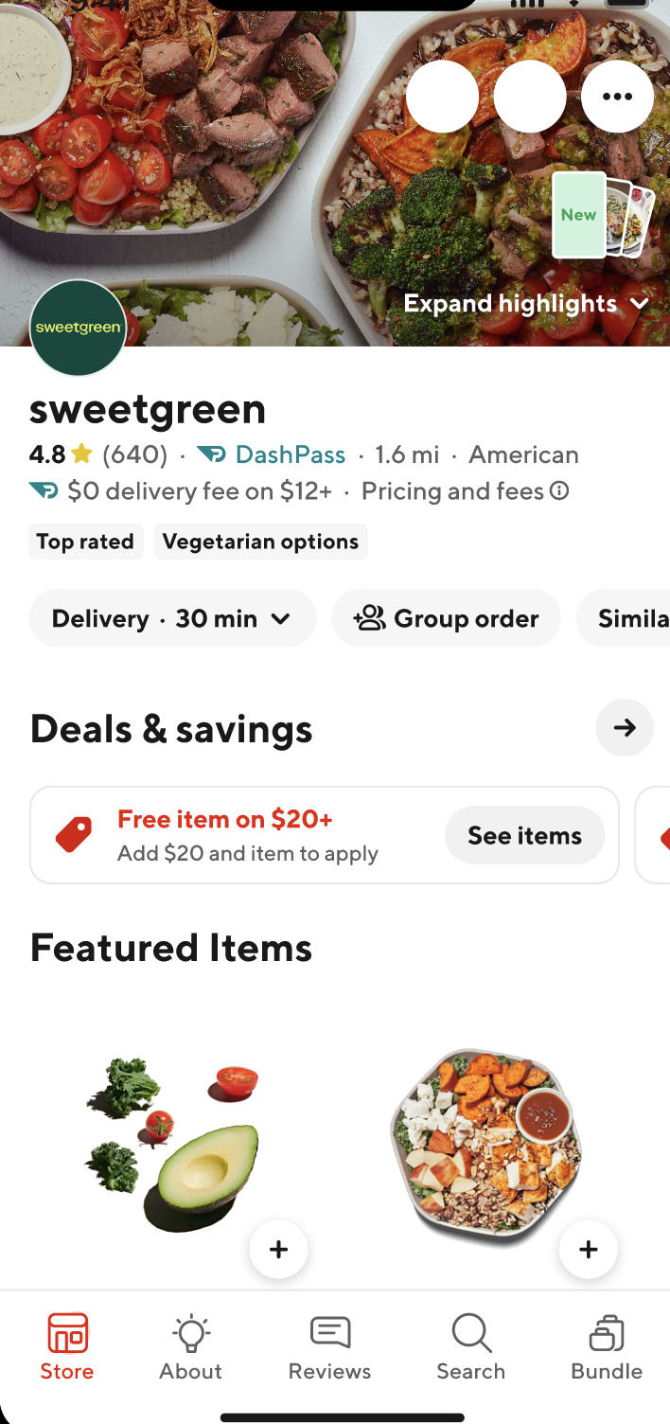
Cx expect the free item to be at the top of the store page; the USI mostly meets this need
Cx indicated that they expected to see a banner or ad at the top of the page with the free item. 3 out of 8 Cx indicated there should probably be a menu section for free items.
Cx noticed the USI right away, mostly due to to its location. They felt it was clear to get the information, but 4 out of 8 were frustrated to have to click to another step to learn more.

Slide 10
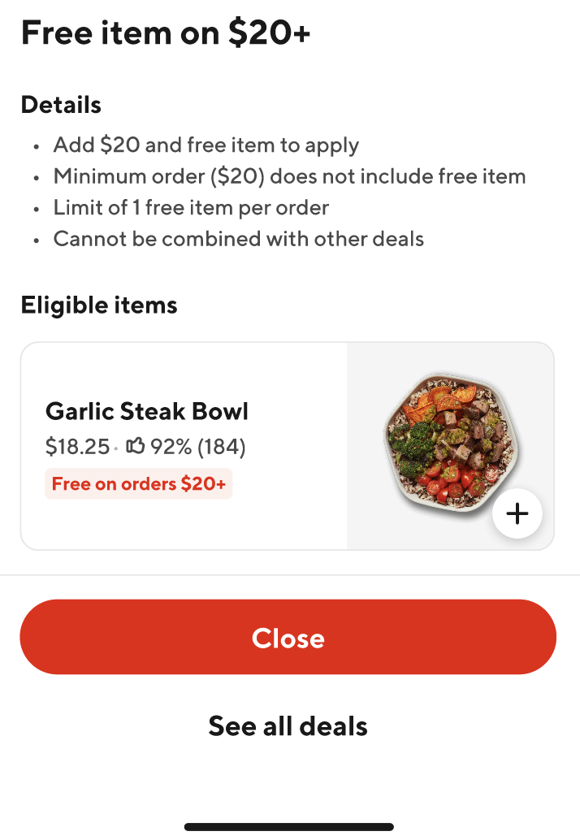
Promo description was short but not simple
Cx found this language very confusing and found the bullets contradictory
  Add the item, but it’s not included?
  What do I have to apply for?
Need to call out if total requirements are before or after fees/tax/tip
Cx felt we were making it take even longer to assess interest by making them read details before showing the eligible items
Cx did not recognize the value of the item and therefore the value of the savings, we can do better to call this out
Cx were unclear about the call to action, are they supposed to add it or start shopping. What's the next step?

Slide 11
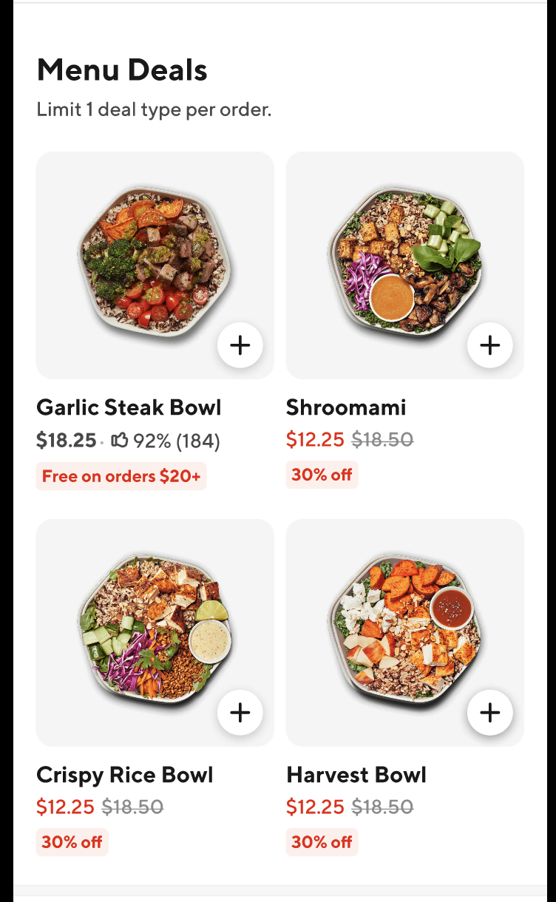

In menu merchandising also proved confusing for some Cx
Only half of Cx noticed the badge under the item
2 out of 8 Cx did not understand that the badge meant it was the free item; they instead though it was a repeat advertisement from the homepage
Cx were particularly confused when seeing the badge next to the 30% off badge because of the inconsistencies in formatting between the two offers

Slide 12
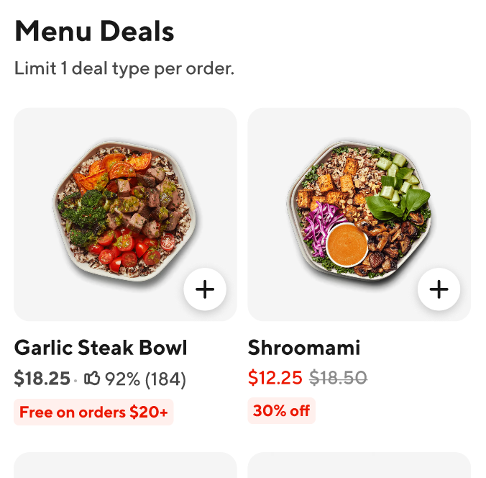
Store page merchandising + unstackable deals= Cx confusion & mistrust
Context: In the prototype, Cx had multiple deals available at the store. Other deals were highlighted using strikethrough pricing & badging on the store page, but when added to the cart the full item price was shown.
Every Cx caught on to the change in price for the 30% item, just at different phases- some Cx saw it right away via the progress bar while others didn’t realize until the cart phase
All Cx found this experience to be extremely frustrating and many expressed it would be a big trust buster for them for DoorDash
25% of Cx indicated they were likely to walk away from the Rx or DoorDash if they experienced this

Slide 13
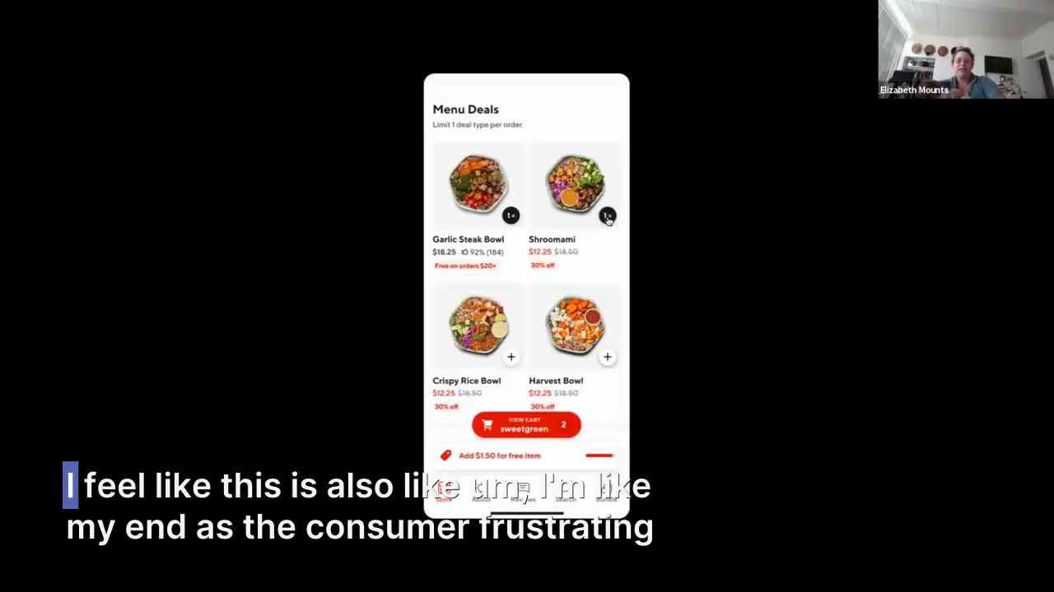
Cx struggled to make sense of the pricing switch during the interviews…

Slide 14
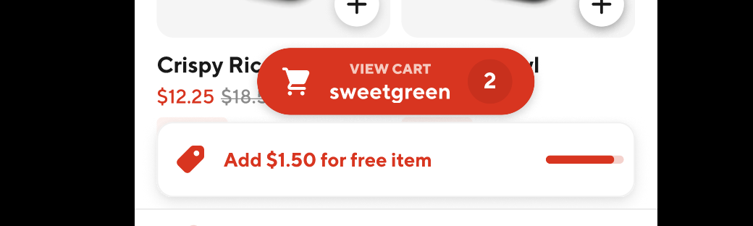
Most Cx would build their cart before the free item
6 out of 8 Cx indicated they would prefer to build a cart to the required minimum before “unlocking” the free item
Cx found the progress bar to be clear and helpful either way, but would rather select the item once the $20 was reached

Slide 15
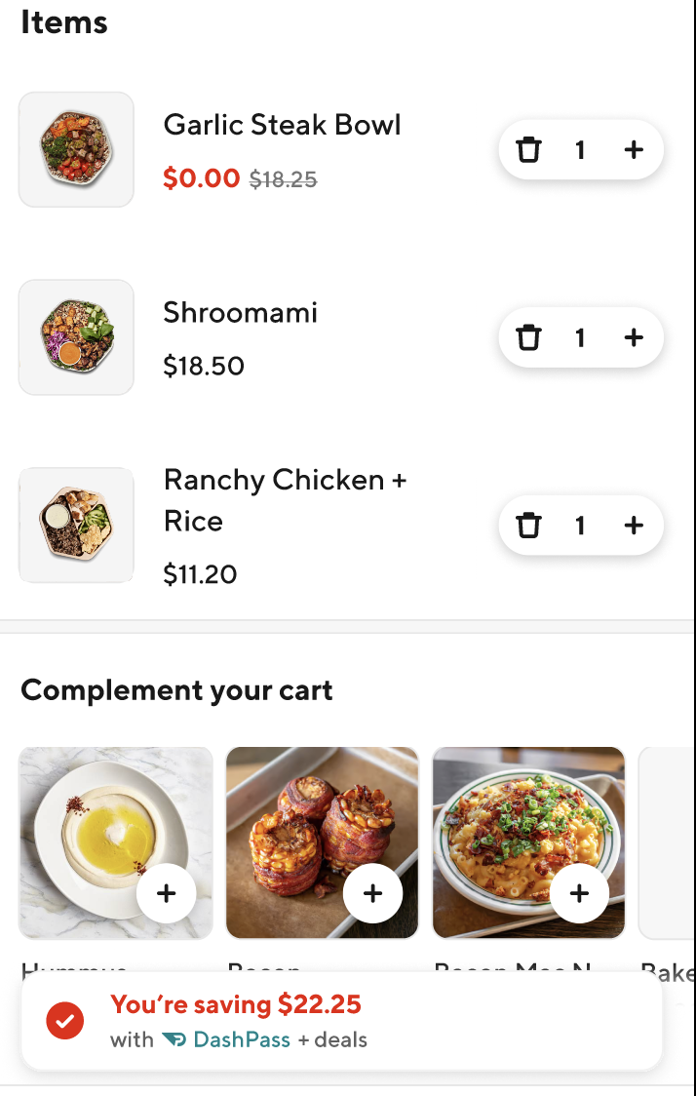
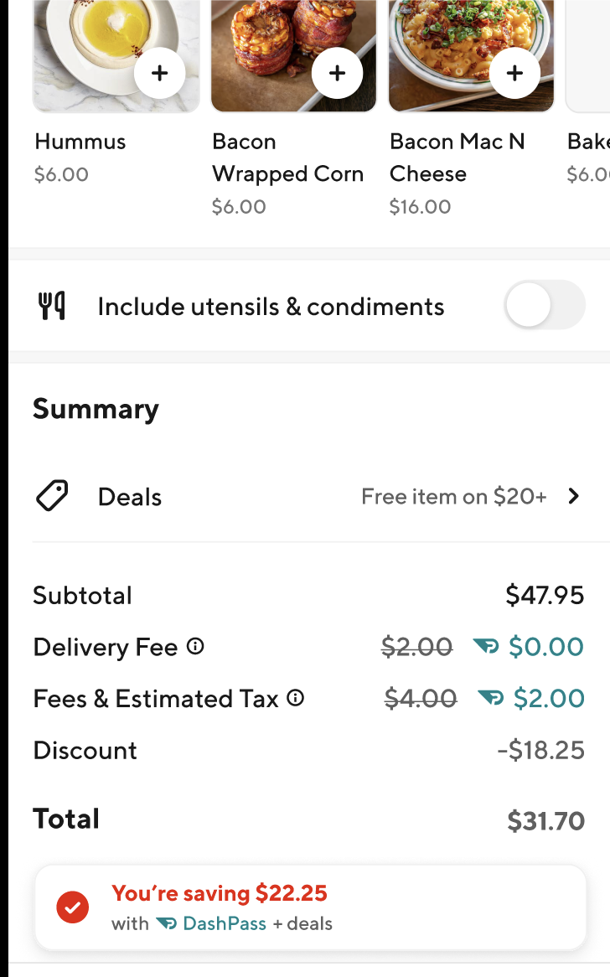
Cart page is mostly clear but can be improved
Items section and summary section were so spread out
Cx felt the deal applied didn’t really connect to the discount in this format
Half of Cx did not realize they could swap the promo on the cart page if they wanted to

Slide 16
Some other unique ideas from our Cx…

Slide 17

Make deal communications feel more like social
Provide a visual cue similar to “open to work” on LinkedIn
Any Rx that currently has deals available would have the band indicating that there are opportunities to save
You can then click on the store icon to see all deals available (similar to the experience of clicking through stories on IG)

Slide 18
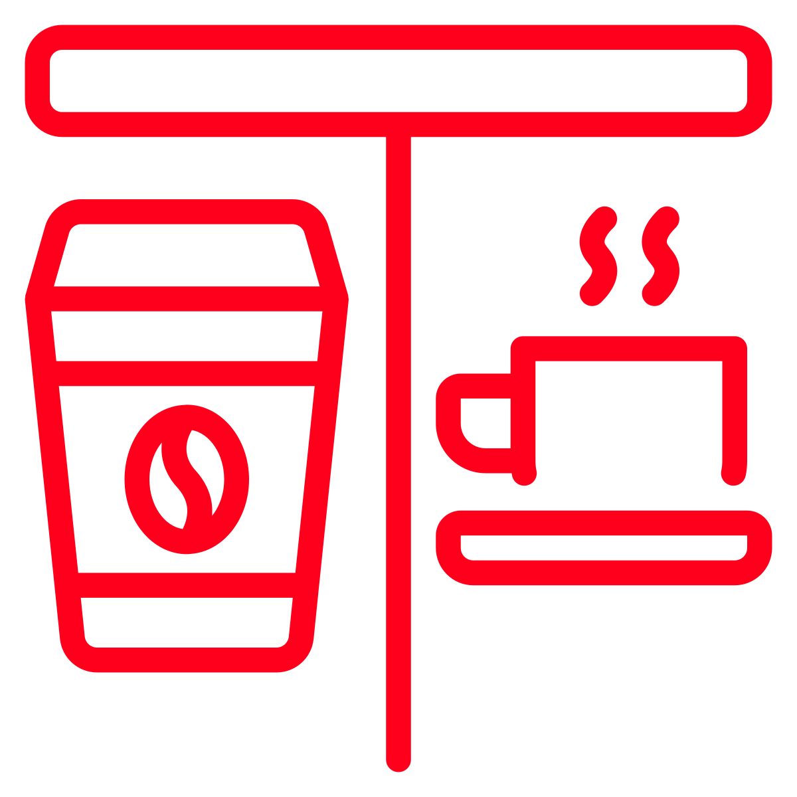
Faster toggling on the cart page
Two Cx said it would be extremely helpful that if you clicked the arrow to select between multiple promotions that it would show you both the promotions available and how it would impact your cart total

Slide 19
Detailed Recommendations

Slide 20
Item promo experience (1 of 2)
UXR Recommendation | Cx Detailed Insight
For high value item promos indicate the item (e.g. app, entree, dessert) in the badge description for clarity. On the store page, the badge should include the pricing (e.g. $0 when spend $20+) | On the homepage, the value of the item is not understood and therefore does not generate interest among Cx On the store page, half of Cx did not connect that the badge meant that item was the free item, instead it felt like a continued advertisement for the deal at the store
Exclude low value item promotions from Mx options | Most Cx typically ignore item promotions because they assume they are low value items Cx are less interested in savings that are less than $5
We should only show strikethrough on the menu page of the deal that is being highlighted in the progress bar/cart. In lieu of stackability we should only allow one item promo per Mx to avoid confusion. | Cx assume they are getting the strike through pricing even though they know they only can use one deal per order (this is because they are not connecting the badge) Cx found it to be very sneaky when the progress bar and/or cart did not show the prices they expected, they felt it would really cause them to lose trust in DoorDash if that noticed that without explanation Cx are already somewhat skeptical about these deals, any additional trust busters may cause them to abandon their cart Seeing the strikethrough pricing makes them think the 30% off deal is better than the free item, even though the value of the free item is almost double that of the 30% deal

Slide 21
Item promo experience (2 of 2)
UXR Recommendation | Cx Detailed Insight
The item details should be edited by content and tested further to ensure clarity & simplicity | Cx find the information in the USI to be confusing They feel the free item should be on the top (don't bury it further) They didn’t get a clear sense of the value of the item Some of the wording of the details felt unnecessarily complicated
We should continue to push to have some sort of item visual or text explanation within the USI to more quickly connect Cx with the free item information. | Overall the USI does it’s job of alerting Cx to what the free items are and felt clear and prominent Ideally in a future state Cx would want more detail in the USI on the store page without having to click further
The location of a featured item vs. menu item should not matter because Cx will see the free item in the USI; if we do merchandise within the store it is critical that strike through and badging is clear and consistent across offers. | When it comes to providing the free item outside of the USI, Cx are split between having a specific menu section vs. having it in the featured items Some of this may be due to the fact that it's not always clear that is the free item with the badging It was not clear where Cx should look or click to find details on the other discounts available at the same store

Slide 22
Broader promo ecosystem
UXR Recommendation | Cx Detailed Insight
There is a broader need for consistent badge requirements. Ideally all badges should include value and any minimum spend requirements. | Cx have a very hard time understanding deals when there is not consistent language in the badge (percentage off, minimum spend, maximum savings, value of savings) In the examples shown Cx actually think that the lower value deal is more valuable because there is a clear savings amount
We should work closely with the checkout team to streamline and clarify how deals are shown within the cart summary. Additionally as more Rx have multiple non-stackable promos available we will need to make it more clear to Cx how and where they can swap between promotions on the cart page. | Cx would like to see the item prices with the deals closer to the full details Cx would like to see what the discount is next to where it says discounts Half of Cx were unclear that they could select other promotions on the cart page

Slide 23
Thank you!

